Slide 1
Assignment 6 Point Cloud Segmentation and Robot Path Planning
Guidebook: Real Robot Experiments.
Prof. Yantao Yu
Wenyu Li
The Hong Kong University of Science and Technology (HKUST)

Slide 2
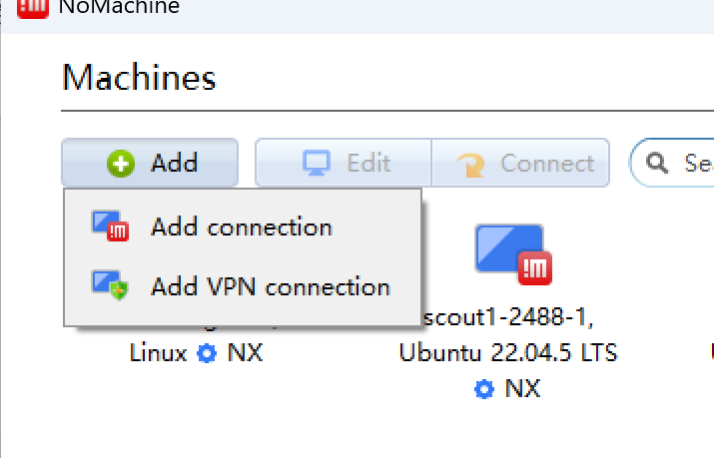
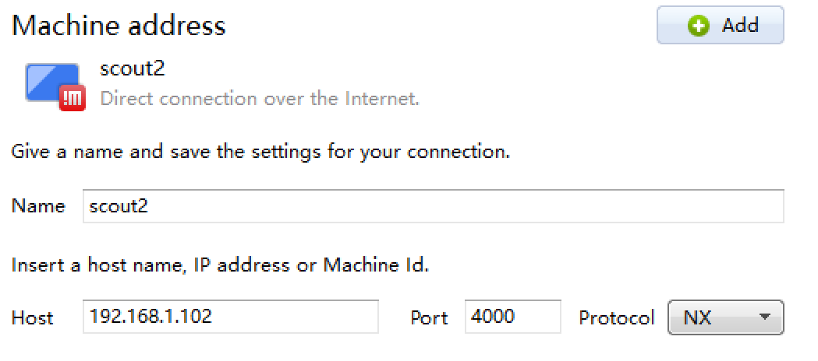
Agilex Scout
Download and install nomachine on your laptop
Name: the name can be anything
Host: must be 192.168.1.102 for agilex scout robot

Slide 3
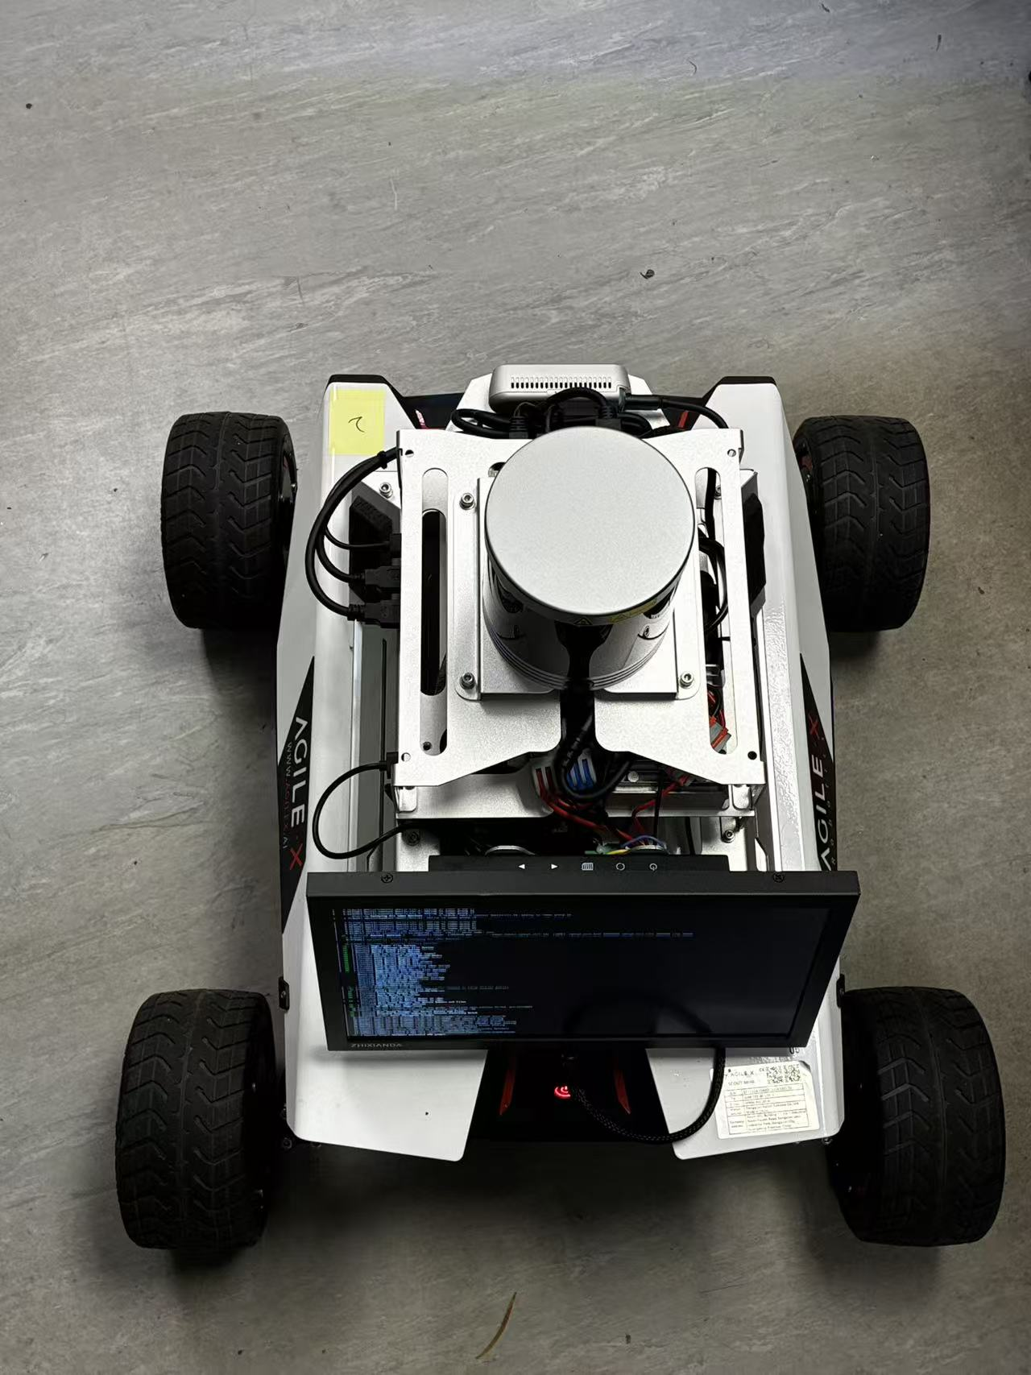
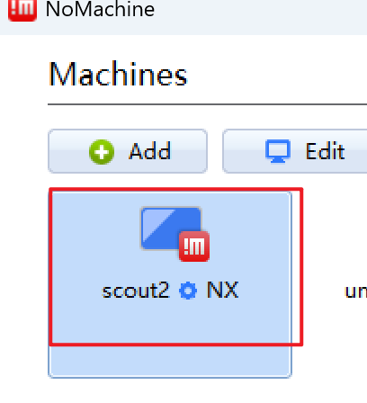
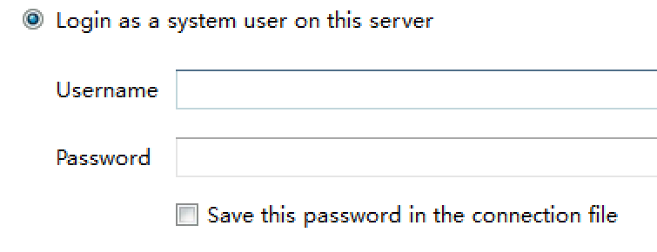
Agilex Scout
Start the robot
press the button
Connect your laptop to the wifi
Wait until you see the wifi of your robot
name: agilex-2488-x-5g
password: 12345678
x the is number of the robot (e.g., agilex-2488-1-5g)
Connect the scout robot using nomachine
username: hcic password: agilexscout1
The position of the number and button

Slide 4
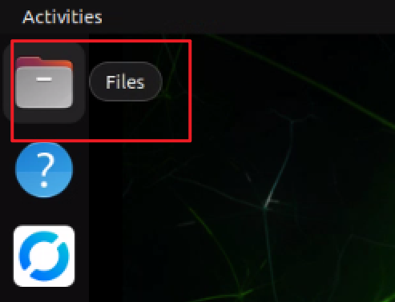
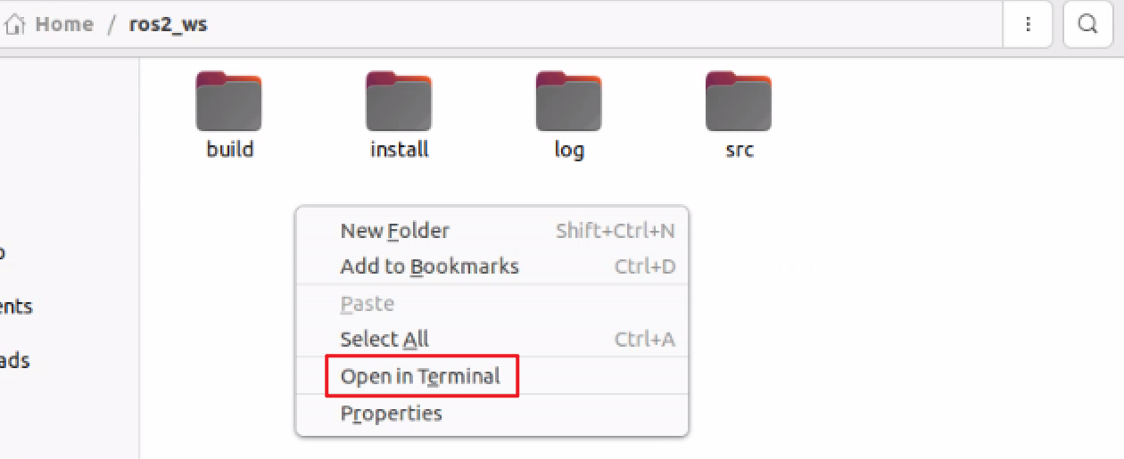
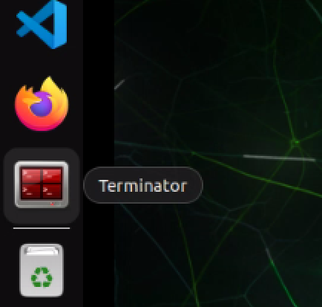
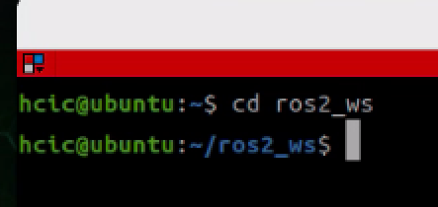
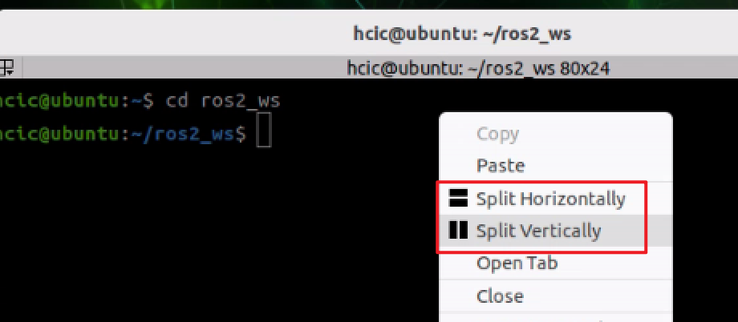
Agilex Scout
Ubuntu
Username: hcic password: agilexscout1
In ubuntu system
open ros2_ws folder and open a terminal
or open terminator, open ros2_ws and split the screen

Slide 5
Agilex Scout
Experiment:
Open three terminal in ros2_ws folder or split three screen use terminator.
Run:
ros2 launch robot_nav robot_platform.launch.py
ros2 launch robot_nav robot_localization.launch.py
ros2 launch robot_nav robot_planning.launch.py

Slide 6
Agilex Scout
How to shut down the robot
Just click the button

Slide 8
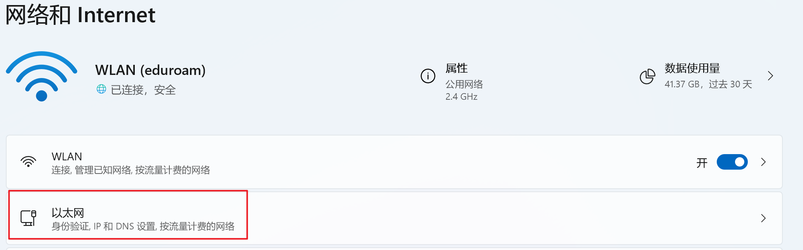
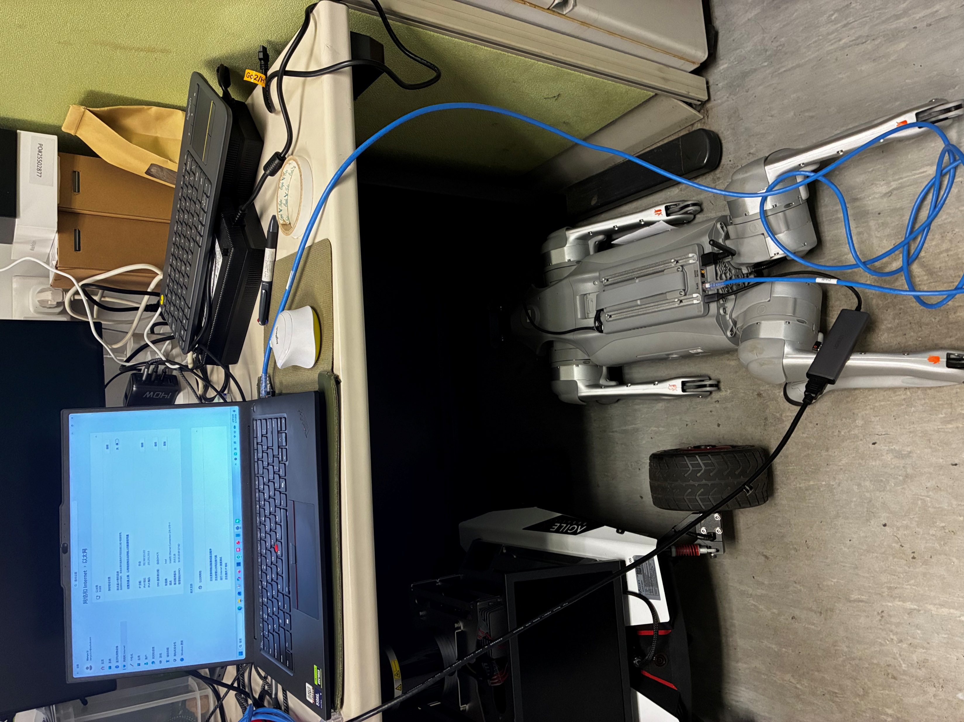
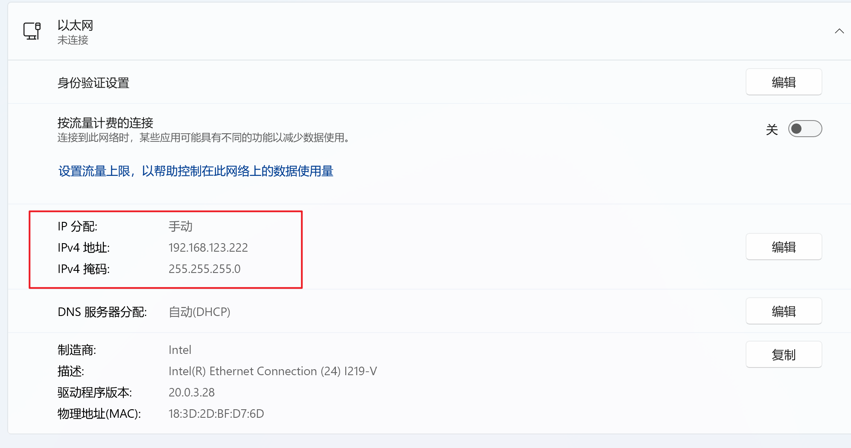
Unitree Go2
Connect the go2 to the laptop using an Ethernet cable.
set ip of your laptop
Ipv4:192.168.123.222
Subnet mask​:255.255.255.0
Ask TA for assistance if you have no Ethernet port or have any difficult.

Slide 9
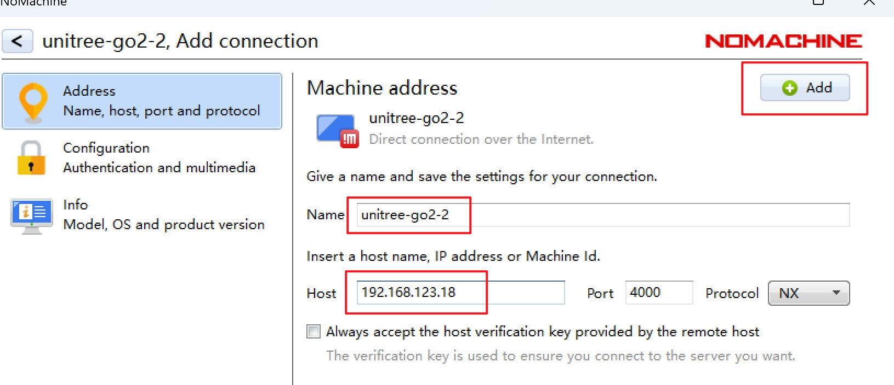
Unitree Go2
Download and install nomachine on your laptop
Name: the name can be anything
Host: must be 192.168.123.18 for unitree go2 robot

Slide 10
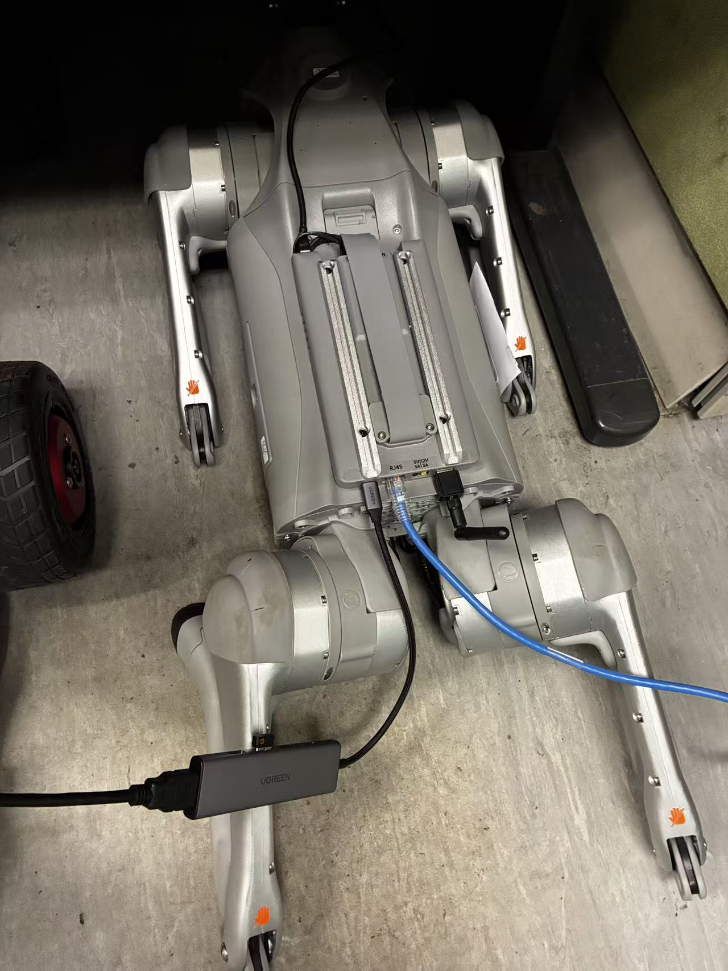
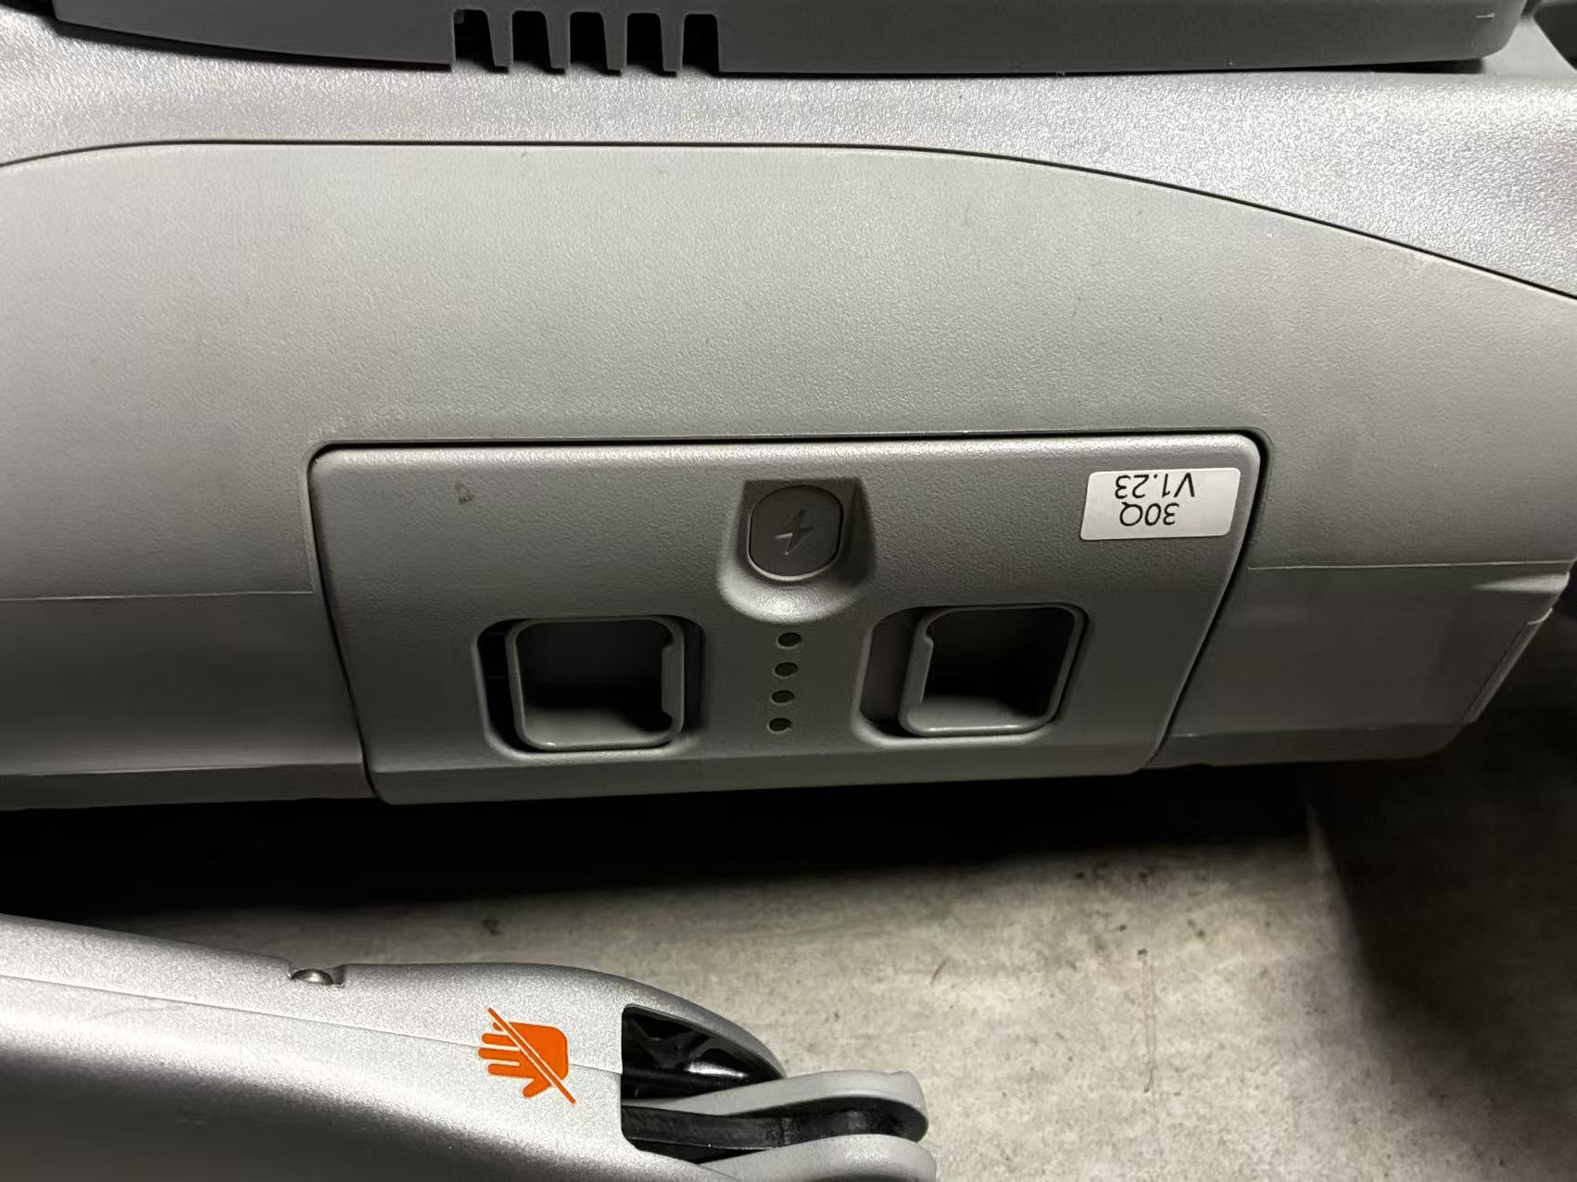
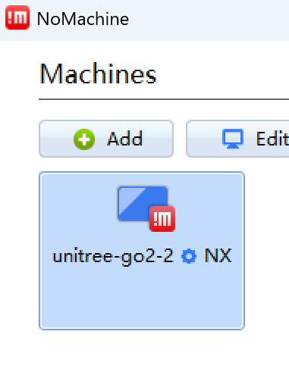
Unitree Go2
Start the robot
The robot dog must be positioned in the posture shown in the figure before it is powered on.
press the button once, then a long press to start the robot
Connect the go2 robot using nomachine
username: unitree password: 123
correct posture
button on the robot

Slide 11
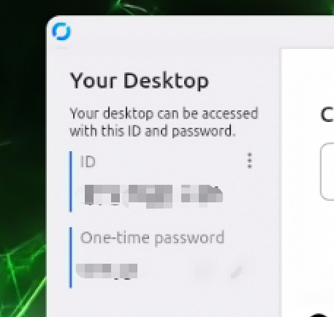
Unitree Go2
However, we can only develop using a cable.
For convenience, connect the Go2 to Wi‑Fi(eduroam or mobile hotspot).
Connect go2 using rustdesk (install it on your laptop,and check the rustdesk id and password in go2)

Slide 12
Unitree Go2
Ubuntu
Username: unitree password: 123
Experiment:
Open terminal in autonomy_stack_go2 folder
Run:
./system_real_robot.sh
or
ros2 launch vehicle_simulator system_real_robot.launch

Slide 13
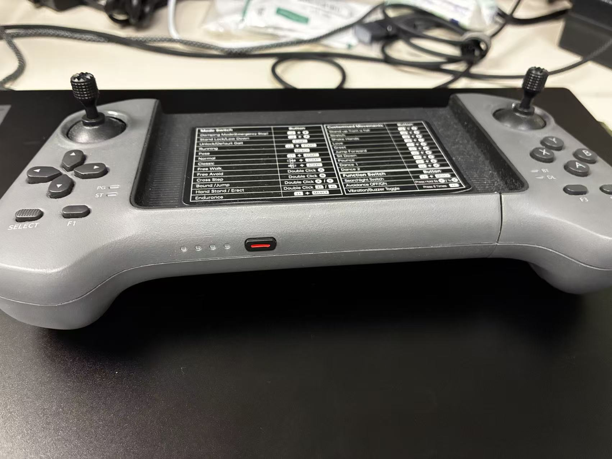

Unitree Go2
How to shut down the robot
Powering off the robot must use the controller.
Press the button on the controller once, then press it longer ​ to power on the controller.
Press L2 + A​ to make the robot dog lower itself.
Press the button on the robot dog once, then press and hold it​ to shut the robot down.
button on the controller
L2 +A

